Slide 1

Career Development Theory and its Applications
Chapter 3

Slide 2
Learning Objectives
Review key career development theories, models, and techniques and apply them to the client populations you serve.
Define the following terms: occupation, job, career, career development, career counseling, career assistance, career guidance, and career planning process.
Describe the steps in the career development process.
State the reasons why understanding career choice and development theory is important.
State the limitations of career choice and development theories.
Explain the importance of Maslow’s Hierarchy of Needs to the work of a career services provider.
Describe in detail the assumptions that underlie each of the four theory types: trait-and-factor, learning, developmental, and transition.
Review the details of additional career development theories.
Describe specific ways each of these theories can be applied to client cases.

Slide 3
Definitions
Occupation — a defined set of work tasks commonly performed for the purpose of making a particular product or performing a specific service
Job — performance of an occupation in a specific place for a specific employer
Career — the combination of activities performed at any given life stage in all roles of life, including the role of worker

Slide 4
Definitions
Career Coach: a person who guides another in planning and managing their career and developing an array of options related to career goals.
Career development — sequence of career-related choices and transitions made over the life span
Career counseling — the process by which a professional counselor provides assistance to clients so that they can make informed career choices and transitions
Career assistance — the process by which a Career Development Facilitator provides defined kinds of support to clients, including helping to find career information or conduct a job search
Career guidance — a planned, sequential program of services provided to individuals of groups for the purpose of assisting them in making informed career choices and transitions
Career planning process — the steps an individual goes through in order to plan a career

Slide 5
The Career Planning Process
Become
Become aware of need to make career decisions
Learn about
Learn about and/or reevaluate self
Identify
Identify Occupational alternatives
Obtain
Obtain information about identified alternatives
Make
Make tentative choices from among available occupations
Make
Make educational choices
Get
Get a job

Slide 6

Role of the Career Services Provider
To help clients understand the process
To offer activities and resources that may help to identify and clarify alternatives
To assist clients to use the information gained in ways that help with making a choice
To refer clients for assistance from others if their needs exceed the scope of your work and training

Slide 7
Importance of Theories
Attempt to explain both the factors involved in the career planning process and the way they work together.
Attempt to predict future events, such as satisfaction/dissatisfaction in a specific kind of work
Provide guidelines, tools, and techniques for practice.

Slide 8
Limitations of Theories
Each theorist looks at career choice and development from a different perspective and focuses heavily on specific selected aspects.
Samples used for research may not be representative of total population
Theories may not apply as well to minority groups as they do to the groups on which they were originally formed and tested
They are culture bound
Many different types of career development theories

Slide 9
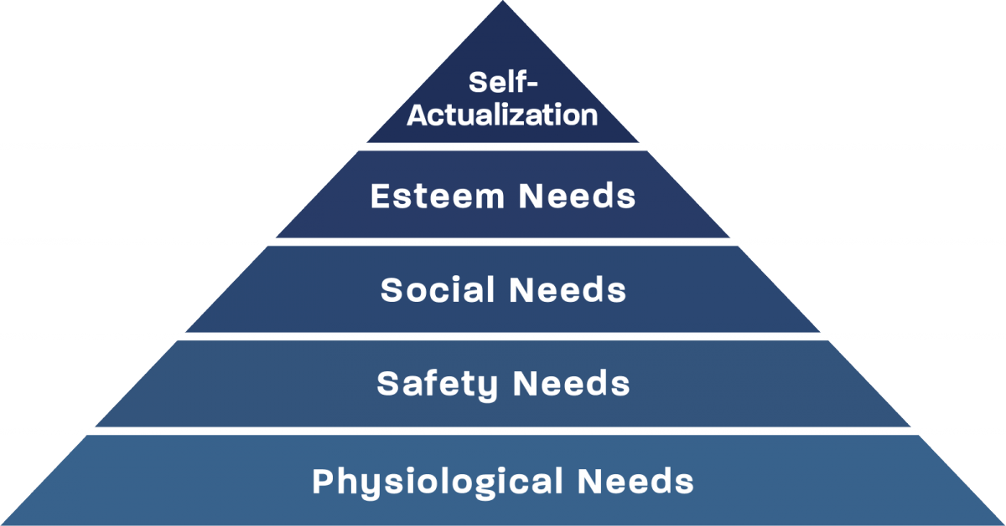
Maslow’s Hierarchy of Needs

Slide 10

Trait-and-Factor Theory
Individuals have unique characteristics related to interests, abilities, needs, values, and personality traits.
Occupations and jobs have unique characteristics related to work tasks, skills, demands, and rewards.
The unique characteristics of both individuals and occupations/jobs can be measured.
Workers and employers are most satisfied when there is a good match or “fit” between the characteristics

Slide 11
Basic Concepts of Vocational Choice Theory (Holland)
Each individual can be described as a combination of three or more “types”
Environments can be described as a combination of three or more “types”
Individuals seek environments which have the same or similar type as theirs
Finding such a match predicts satisfaction, longevity, and contribution

Slide 12

Holland’s Six Types
Realistic — tends to work with hands, tools, equipment, and sees tangible results; often has mechanical abilities and is a problem solver
Investigative — often values abstract thinking, ideas; prefers to work alone; introspective, analytical, and curious
Artistic — independent, nonconforming, intuitive, and values the creative expression of ideas and emotions
Social — prefers working with others to inform, counsel, train, develop, cure, and/or enlighten
Enterprising — works face-to-face with people to sell, lead, manage; high value on influencing others
Conventional — prefer to work with explicit, ordered, and systematic manipulation of data and information

Slide 13
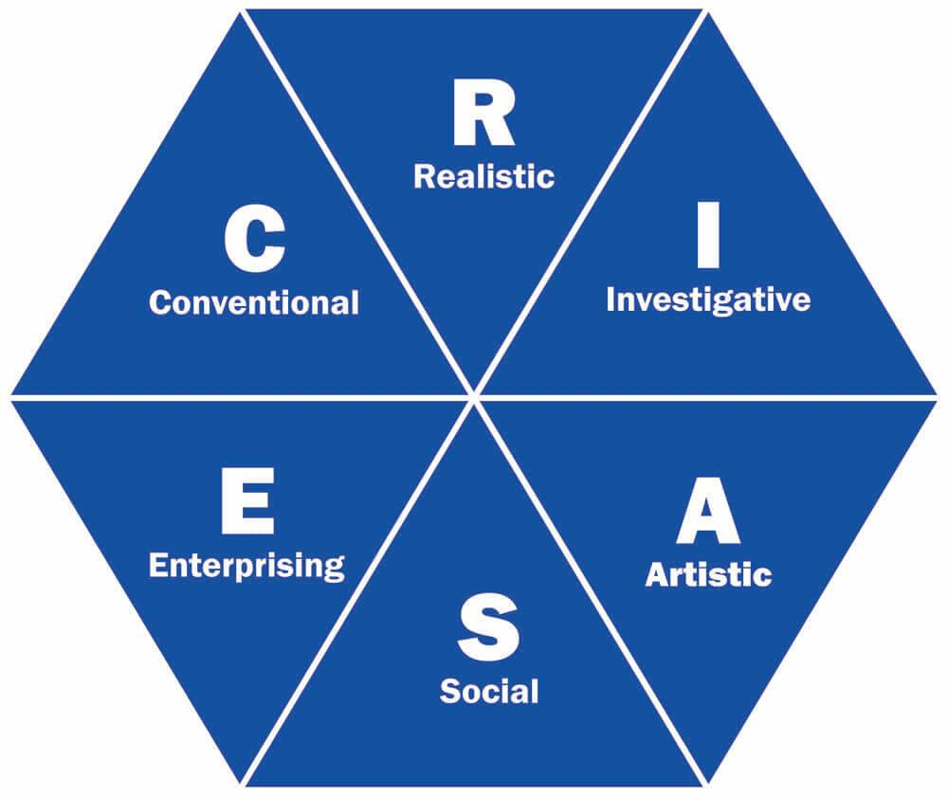
Holland’s Hexagon

Slide 14
Three Important Concepts
Consistency — the relationship of the first two letters of a Holland code as indicated by the hexagon
Differentiation — the numerical difference between the lowest and highest of the six scores of a profile
Congruence — the degree of “fit” between a person’s personality type and a work environment

Slide 15
Personal Codes
An individual’s Holland code is usually expressed as a two- or three-letter code
Two or more letters may be “tied,” however, in any one of the 3 positions
An individual’s code can be determined by
Completing an informal assessment
Administering an interest inventory
Examining past jobs

Slide 16

Practical Applications of Holland’s Theory
To learn about the interests and preferences of individuals
To assist individuals to find jobs where they can express their interests
To assist individuals to choose majors, schools, and leisure activities
To understand why people are satisfied or dissatisfied in their work
To organize high school curriculum or college majors
To organize career information, job shadowing, and career days
To provide the structure for career guidance services

Slide 17
Learning Theory
There are three important determinants of career choice and development:
heredity,
environment, and
learning experiences
Career services providers can have impact on the third, but it is useful to understand the impact of heredity and environment
Positive reinforcement occurs when specific behaviors are rewarded.
Negative reinforcement occurs when some aversive stimulus is terminated.

Slide 18

Types of Learning
Instrumental — positive outcomes (praise, financial return, positive emotions) follow a given behavior
Associative — people observe outcomes that are experienced by others and take these persons as role models.

Slide 19

Happenstance Theory
Career service providers should encourage clients to explore and take advantage of the unexpected
While maintaining an attitude of planning, one is also open to exploration and unexpected opportunities
“Chance” events can have a positive or negative influence on us.
Things happen, and sometimes turn into new opportunities.
The four key attitudes to foster regarding unexpected events are:
  Curiosity
  Persistence
  Flexibility
  Optimism

Slide 20

Practical Application of Krumboltz’s
Social Learning Theory
The following concepts are typically used when applying this theory:
  instrumental learning
  associative learning
  reinforcement (both positive and negative)
  modeling
  observing
  practicing
  happenstance

Slide 21

Developmental Theory
Focuses on how careers unfold over the life span.
Factors that contribute to growth and maturity are complex and multifaceted.
Life can be divided into a specific number of age-related stages.
Each stage is characterized by specific developmental tasks that should be accomplished during that stage.
Though there is a variation in timing, most people experience these stages and tasks at some point in their lives

Slide 22
Career Development Theory of
Donald E. Super
Leading developmental theorist is Donald Super.
There are three aspects to his theory:
self-concept
life span
life space
The nature of the career pattern is determined by:
individual’s parental socioeconomic level
mental ability
education
skills
personality characteristics
career maturity
and by the opportunities to which an individual is exposed

Slide 23
Self-concept
Formation of a self-concept begins as soon as a baby realizes that he or she is a separate being
Growth and richness of the self-concept continues throughout our entire lives.
Its development is influenced by:
the culture in which we live
the family in which we are born
the experiences that we have
and the events that befall us
Self-concept is a picture of who we are and what we are like.
It is a blend of:
how we see ourselves
how we would like to be seen
and how we think others view us
It includes both subjective and objective information.

Slide 24
Super’s Stages and Approximate Ages
STAGE AGE
Growth 0–15
Exploration 15–25
Establishment 25–45
Maintenance 45–65
Disengagement 65–?

Slide 25
Super’s Five Developmental Tasks
Crystallization
Specification
Implementation
Stabilization
Consolidation

Slide 26

Life Space - The Breadth of One’s Career According to Super
LIFE SPACE is a term used to describe all of the time and energy that we have.
CAREER is the combination of life roles being played at any given point across the life span as represented on the Career Rainbow
  Distance from left to right on the rainbow represents time, with birth at the far left and death at the far right.
  Each band represents one of the major life roles.

Slide 27
The Career Rainbow
Citizen
Leisurite
Parent
Homemaker
Spouse
Worker
Student
Son/Daughter

Slide 28
Nature of Life Roles
Roles change in bandwidth and intensity over the life span
Roles inevitably interact with each other and affect each other
Interests, skills, and values can be assigned to a variety of life roles
Satisfaction and stress that one experiences in life are often directly related to the number and combination of roles being played

Slide 29
Definition of Super’s Eight Roles
Son/Daughter — the time and energy spent in relating to parents
Student/Learner — the time and energy spent in learning and acquiring skills
Worker — the time and energy spent in paid employment
Spouse/Partner — the time and energy spent in cultivating and maintaining a relationship with a partner
Homemaker—the time and energy spent by either men or women in preparing food, cleaning, and all other activities related to maintaining the place where we live
Parent — the time and energy spent in rearing children
Leisurite - the time and energy spent in activities for relaxation, including reading, sports activities, going out to dinner, etc.
Citizen — the time and energy spent in volunteer activities in the community

Slide 30
Importance of Values
List of values that people attempt to attain through work
Ability utilization
Achievement
Aesthetics
Altruism
Autonomy
Creativity
Economic Rewards
Lifestyle
Physical activity
Prestige
Risk
Social interaction
Variety
Surroundings

Slide 31
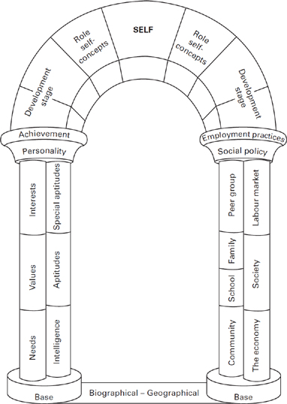
The Archway of Career Determinants

Slide 32

Practical Applications of Super’s Developmental Theory
Importance of helping the client/student explore cultural influences and in particular, those influences that have an impact on one’s career development and perceptions of the work role
Using the Career Rainbow to assist young people in planning for future life roles and to assist adults in balancing their life roles
Assisting individuals in assessing their personal values
Assisting people in understanding their vocational self-concept

Slide 33
Transition Theory
Life is characterized by change and an ongoing series of transitions.
Transitions can be viewed as events (or nonevents) that cause change in an individual’s roles, relationships, or routines.
Transitions have varying degrees of impact on different individuals, depending upon a number of factors.
Success in life may be more closely related to the ability of individuals to cope effectively with change and transition than to life’s events in general.

Slide 34
Schlossberg’s Definitions
An event is something that happens, such as getting married, having a child, receiving a promotion, or getting into your first-choice school
A nonevent is something that you expected and wanted to happen, but it did not — like not getting married, not having a child, not receiving a promotion as expected, not getting accepted into school

Slide 35
Schlossberg’s 4-S Transition Theory
SITUATION
Timing
Impact
Control
SELF
Coping skills
Competencies
Outlook on life
SUPPORTS
People
Agencies
Financial capability
STRATEGIES
Additional support?
Alternatives?
Steps to take?

Slide 36
The Situation
On a 1–10 scale, how “bad” is it?
What is its timing (worst or best possible time)?
How long is there to absorb its impact?
Is there anything positive about it?
How much control can I exert over it?
Is it temporary or permanent?
What else is going on in the person’s life at the same time?

Slide 37

The Self
Do I see the glass as half empty or half full?
Do I believe that I can exert control?
Have I had past successful experience with change?
Do I know how to cope by using humor, relaxation, exercise, meditation, etc.?
What internal resources do I bring?

Slide 38
The Support System
Do I have friends and family who are willing to help me through a transition?
Am I willing to ask for help or develop a network of supporters?
Are there agencies that can help?
Are there sufficient material resources to help?

Slide 39

Formulating Strategies
Are there inner resources that could be developed?
Do I know how to develop an action plan and then follow it?
What are the alternatives available?
What is the time frame for carrying out these strategies?

Slide 40
Other Theories
Integrative Life Planning Theory
a way of seeing self and world that takes into account both personal development and the contexts in which we live
Cognitive Information Processing Theory
looks at three factors:
(1) self-understanding;
(2) occupational knowledge;
(3) how we cognitively process this information
Social Cognitive Career Theory
based on the critical relationship among self-efficacy beliefs, outcome expectations, and personal goals
Strengths-Based Approach
changes the focus from problem solving and deficits to a focus on strengths and successes.
Value-Based Career Decision Making
emphasizes the role that values play in career selection

