Slide 1


Debra Ruddell, MS,CCC,GCDF
Certified Career Counselor,
Global Career Development Facilitator
Marketing NCDA Credentials
to
Higher Education

Slide 2
The Value of NCDA Credentials
What is a credential?
A credential represents a formal validation of an individual's qualifications and professional competency in a specific industry.
What is the value of a credential?
An industry certification ensures that you are proficient in a field, while allowing you to enhance your professional brand.
Promote your credential(s) and present your base of knowledge, skills and experience to those you serve.
ncda.org

Slide 3

The ABCs of NCDA Credentialing
CCSP
CCSCC
Certified Career Services Provider
Certified Clinical Supervisor of Career Counseling
CMCS
CCCE
Certified Master of Career Services
Certified Career Counselor Educator
CCC
CSDA
Certified Career Counselor
Certified School Career Development Advisor

Slide 4
The ABCs of Credentialing
NCC
Ph.D.
ICCC
CCSP
GCDF
CMCS
CCC
CEC
CCSCC
LPC
LCSW
CCCE
CSDA
COCC
MCC
BCC
CCP
CCMC

Slide 5

Leadership Academy 2019
Action Learning Project Survey
Graduate Counseling Programs
Higher Ed. Career Centers
Objective:
Develop and Enhance Marketing Plan for
NCDA Credentials Program
.

Slide 6
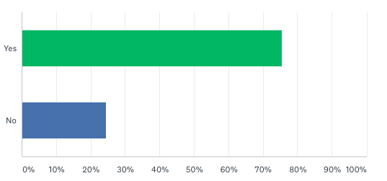
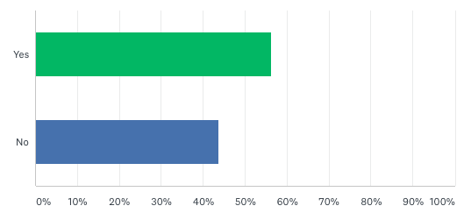
Survey Results
1.
Is your institution aware of the NCDA Credentials that are now offered for Career Counselors and Professionals in Career Services (Coaches, Advisors, Consultants, Trainers)?
76%
24%
2.
Would you like to learn more about the professional certifications offered by the NCDA Credentialing Commission?
56%
44%

Slide 7
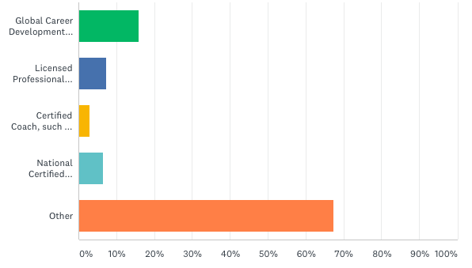
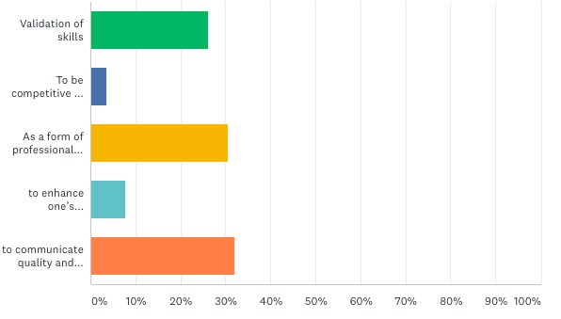
16%
3.
7%
To date, when your Career Center has an opening to fill, what credentials do you seek from candidates?
3%
7%
67%
4.
26%
From your perspective, what is the primary value of earning a credential for career services professionals working in career centers?
4%
30%
8%
32%

Slide 8
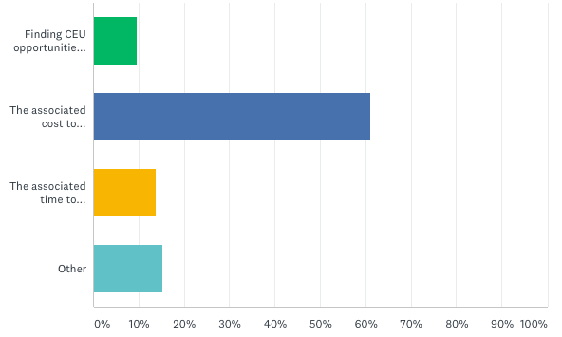
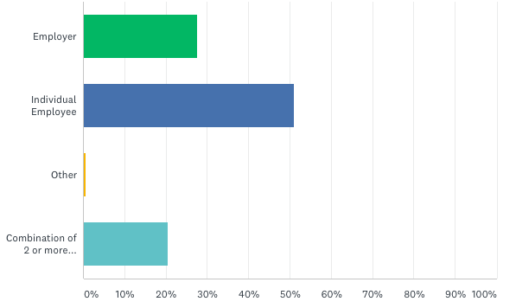
5.
10%
What is your department’s greatest concern involving the earning of a credential?
61%
14%
15%
6.
28%
Who pays for the upkeep of the Professional Career credentials?
51%
1%
20%

Slide 9
Additional Comments:
Testimonials
Student Discounts
Affordable
Graduate Degree vs. Credentials
Employer Requirements
CAREER
Internship
Opportunities
Credential Content
Professional Development
CEUs

Slide 10
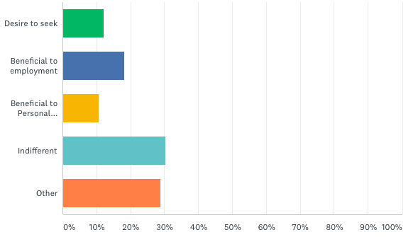
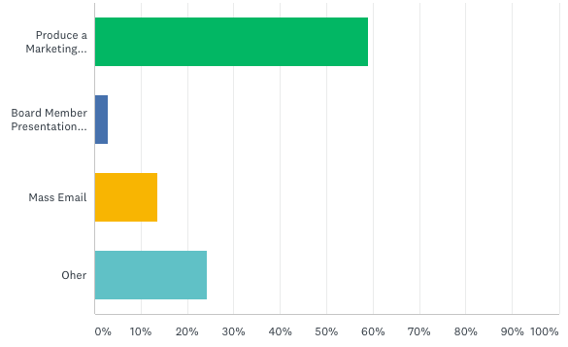
9.
12%
What do your Graduate Students perceive in regard to the NCDA Credentials?
18%
11%
30%
29%
10.
59%
How can NCDA best assist with marketing their Career Credentials to your Graduate Students?
3%
14%
24%

Slide 11
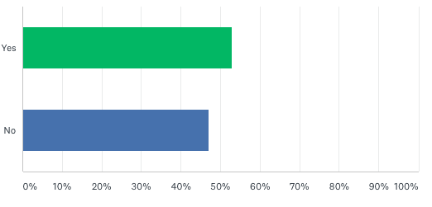


11.
Would there be any interest in partnering with NCDA to promote and provide Internship opportunities, if your program credentials are met?
53%
47%
12.
Career Consultant
Additional Comments:
Career Professional
Intern
Career Level
Graduate
Student

Slide 12

Summary
High interest in learning more about what makes our credentials unique (compared to others).
Overwhelming response to package a marketing plan just for Higher Ed.
Graduate Programs have increasing need for accredited internship opportunities if they knew where the NCDA credentialed counselors worked.
Questions?
Debra Ruddell, MS,CCC,GCDF
Certified Career Counselor,
Global Career Development Facilitator

