Slide 1

Leadership Academy Action Learning Project
Exploring the Role of NCDA in Preparing School Counselors to work with Underrepresented Students in Career Development
June 2019
Carla B. Cheatham, M.Ed., NCC. LPC, CSCDA
School Counselor, Bremen High School
Doctoral Student, Governors State University
Mentor: Constance J. Pritchard

Slide 2


Introduction
This LA project aims:
To explore methods in which NCDA can promote professional development opportunities for school counselors working with underrepresented students in career development.

Slide 3
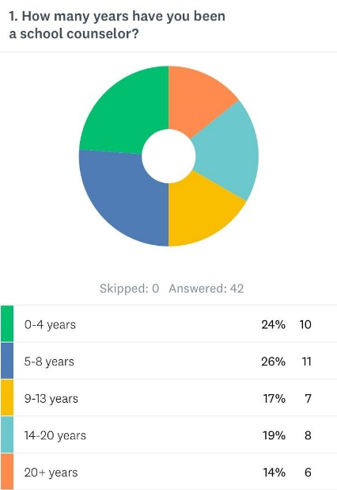
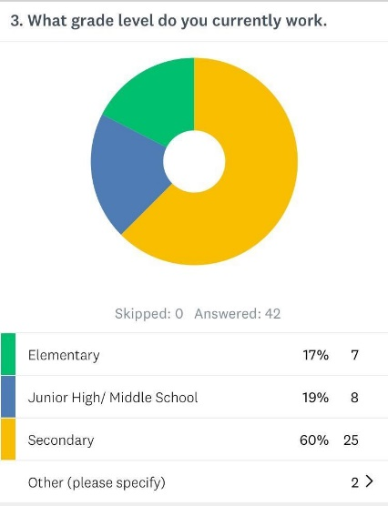
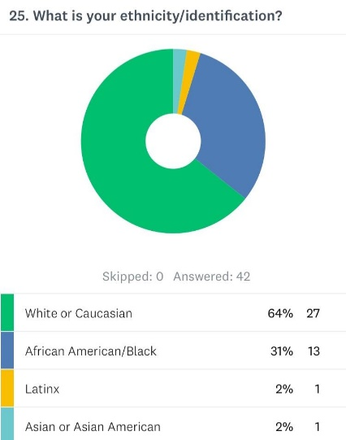
Research Questions
The Overarching Research Focus: There is a need for school counselors to receive additional training in working with underrepresented students in career development.
B. Demographic Information

Slide 4
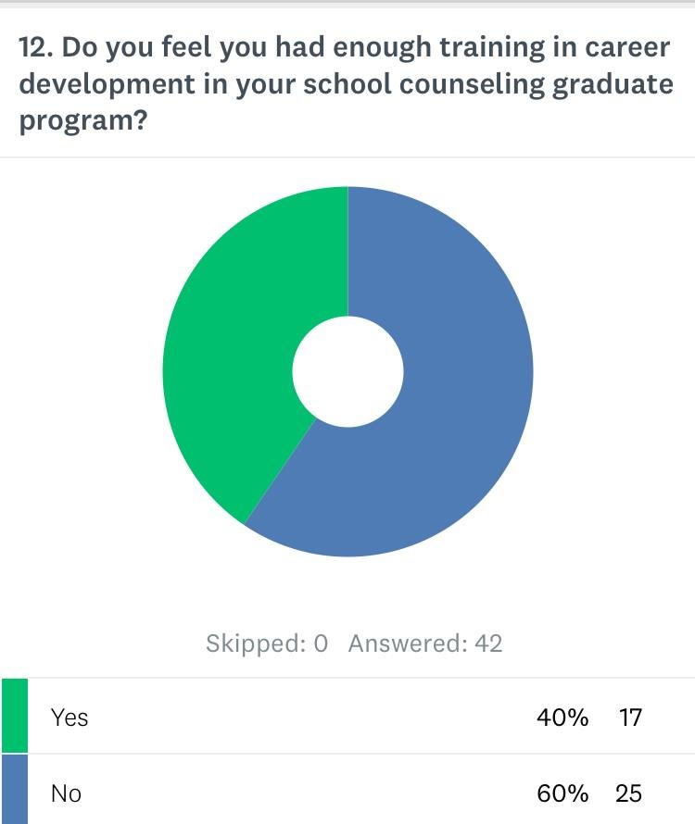

Methods: Procedures
Using CESNET, ASCA Scene, and Colleagues, 42 current school counselors completed the online survey via Survey Monkey.

Slide 5
Methods: Procedures 2
The survey consisted of 30 questions
  Demographics of participating school counselors
  School Counselors view of the importance of career development in their schools
  Career Development preparation
  Preparation in working with diverse students
  Additional training suggestions for working with underrepresented students

Slide 6
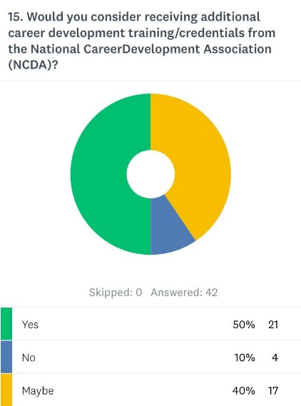
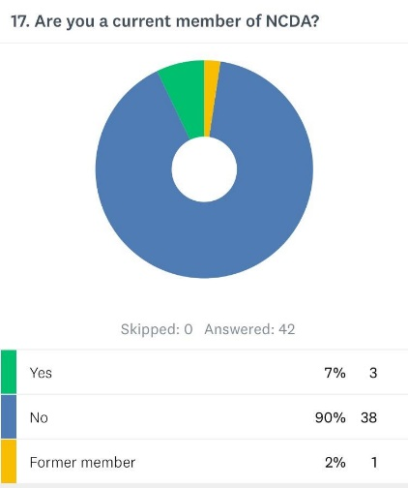

Methods: Data Analysis

Slide 7
Results
Career training that addresses traditions, values, and norms in various cultural groups
Overcoming cultural barriers, social barriers and inequities in career development
Careers for undocumented students
Current NCDA Membership Status

Slide 8
Implementations
Provide opportunities for school counselors to be mentored by members of NCDA in the areas of career development and working with underrepresented students.

Slide 9
Implementations
    Provide monthly or quarterly webinars on the topic of career development and underrepresented students for opportunities for professional development.

Slide 10
Implementations
    Including relating professional development to ESSA career development benchmarks
    Reaching out to school administrators for professional development

Slide 11
Follow-Up Projects or Activities
Open the survey to a larger number of school counselor participants
Include a follow-up survey targeting school administrators
Explore methods of relating SCDA training to current Every Student Succeeds Act (ESSA) requirements to assist school counselors

Slide 12
Follow-Up Projects or Activities
Follow-up survey asking participants what format of career development training they are willing to undergo.
Follow-up survey exploring reasons why school counselors have not joined NCDA

Slide 13

References
Anctil, T.M., Smith, C.K., Schenck, P., & Dahir, C. (2012). Professional school counselors’ career development practices and continuing education needs. The Career Development Quarterly. 60., 109-121.
Crucil, C., & Amundson, N. (2017). Throwing a wrench in the work (s): using multicultural and social justice competency to develop a social justice-oriented employment counseling toolbox. Journal of Employment Counseling. 54, 2-11.
Darrow, A. (2016). The Every Student Succeeds Act (ESSA). General Music Today. 30, 41-44. doi: 10.1177/1048371316658327
Morgan, L.W., Greenwaldt, M.E., & Gosselin, K.P. (2014). School counselors’ perception of competency in career counseling. The Professional Counselor. 4(1), 481-496. 10.15241/lwm.4.5.481

