Slide 1

Leadership Academy Action Learning Project
Career Development Competencies for Working with Veterans
June 2019
Suzette Fletcher, Billings Adult Education
Mentor: Charles Lehman
Heather Robertson: St. John’s University
Mentor: Cheri Butler

Slide 2

Introduction
This Leadership Academy project:
Used current research
Identified competencies for working with Veterans
Proposed a training program for career development professionals
Notes:
We an discuss (if we want) how had originally proposed a certificate and a database however those aspects were put on hold pending NCDA approval/input.

Slide 3
Research Questions
Research Focus
“To ensure that military/veterans in career transition have access to competent, qualified career counselors with military expertise.”
Questions
Challenges for veterans transition?
Resources available?
Preparation for qualified career transition providers?

Slide 4
Methods/Procedures
Reviewed existing literature
Drafted Career Development Competencies for Working with Veterans (CDCV)
Sought feedback from subject matter experts – SMEs (mentors and NCDA Vets Committee)
Incorporated feedback (data analysis)
Developed Training Outline and Timeline
Notes:
I deleted the data analysis slide – do you think that matters? Because our analysis of the data really took place during our procedure?

Slide 5
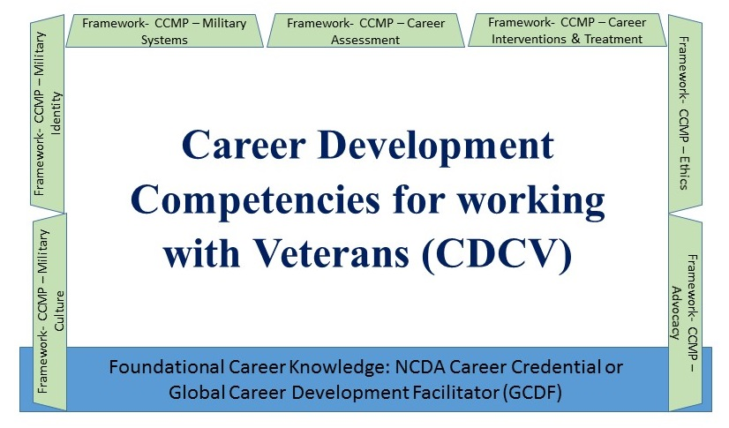
Results:
Competencies Framework
Notes:
Describe the final competencies document – each competency has ~5 objectives below each with further detail on knowledge needed to effectively work with veterans. Citations included throughout the document for literature.

Slide 6
Results:
CDCV Training Development
Identified training content and resources
Developed an Intake Form for Veteran clients
Suggested timeline: curriculum and delivery
  Pre-Conference
  PDI & Conference Sessions
  Post-Conference
Proposed training via NCDA or affiliates
Developed spreadsheet to track assignment completion
Notes:
You can add/change this – I think it’s important to discuss maybe the timeline and how we infused the competencies?? But not sure how to do it succinctly? Maybe with a handout? Proposed training includes
Pre-conference self-directed learning via readings and assignments (~3 – 4 weeks)
Pre-conference self-directed learning via watching videos (~1 week)
An on-site Professional Development Institute (PDI) offered at the NCDA conference
Post-conference homework assignment, conference call, and evaluation of learning (~4 weeks)

Slide 7
Implementation
1. Vetted by Veterans Committee & NCDA
  Competencies
  Training timeline/format
  Training content/delivery
2. Once approved,
  Identify and train instructors
  Develop curriculum resources
  Schedule training for 2020

Slide 8
Follow-Up Projects or Activities
Evaluate and Update
Market and deliver training for 2020
Evaluate outcomes
  Publish success
  Make improvements
Develop Certificate/Credential with NCDA
Schedule and market ongoing training
Create database of career professionals trained to work with veterans
Notes:
This slide seems similar to last slide? Maybe something needs to change on both/either/one of them?

Slide 9
References (partial list)
Literature Reviewed:
NCDA Vets Committee Bibliography
Career Development for Transitioning Veterans Monograph (NCDA publication)
Interviews and Observation of TAP training and military resources
Yellow Ribbon Reintegration Project (YRRP) website
Military Counseling Competencies (2018, MGCA)
Journal of Military and Government Counseling (JMGC)
Career Planning and Adult Development Journal
(Fall 2014 - Veterans Issue)
The Professional Counselor
(Special edition on veterans/military - 2014)

Slide 10
Contact Information
Heather C. Robertson, PhD, LMHC, CASAC
Associate Professor, Counselor Education
Clinical Mental Health Counseling Program Coordinator
St. John's University, School of Education
(718) 990-2108, robertsh@stjohns.edu
Suzette R. Fletcher, M. Ed.
Global Career Development Facilitator
Certified Career Services Provider, NCDA
Billings Adult Education
(406) 861-0055, suzette.fletcher@hotmail.com

